Slide 1
Logistic Regression on Heart Disease Dataset
22/09/2025

Slide 2
Objective
To apply logistic regression to a binary classification problem using the Heart Disease dataset. The dataset contains several features related to a patient's health, and the task is to predict whether or not a patient has heart disease (binary classification).

Slide 3
Overview of the data
Loading the data: data = pd.read_csv(r'C:\Users\user\Downloads\heart_cleveland_upload.csv’)
Converting data into dataframe: pd.DataFrame(data)
Checking the data types: data.dtypes-there were two data types-integer and Floats
checking null Values:data.info()-There were no missing values in the dataset

Slide 4
Checking the duplicates: data.duplicated().sum()-there were no duplicates in the dataset.
data.describe()-there were outliers in the dataset (chol,oldpeak) but the condition had no outliers

Slide 5
Exploratory Data analysis (EDA)

Slide 6
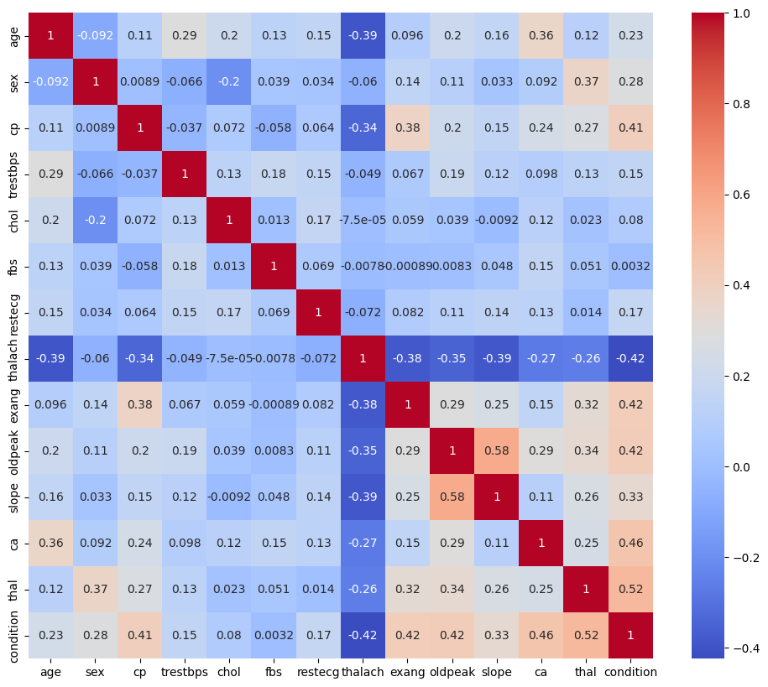
Checking the Correlation #Heat map

Slide 7
Findings from the Heatmap
Positive Correlations:
oldpeak vs slope (0.58): ST depression and slope measurements are closely related - both capture exercise-induced cardiac stress.
thal vs condition (0.52): Thalassemia status strongly correlates with final cardiac condition diagnosis
Negative Correlations:
thalach vs condition (-0.42): Higher maximum heart rate strongly associates with better cardiac outcomes
thalach vs exang (-0.38): Patients achieving higher heart rates less likely to experience exang
thalach vs oldpeak (-0.35): Higher heart rate capacity inversely related to ST depression severity
Diagnostic Variable Clustering
The variables (oldpeak, slope, ca, thal, condition ) form a interconnected cluster with correlations ranging (0.25-0.58), indicating they measure related aspects of cardiac pathology.

Slide 8
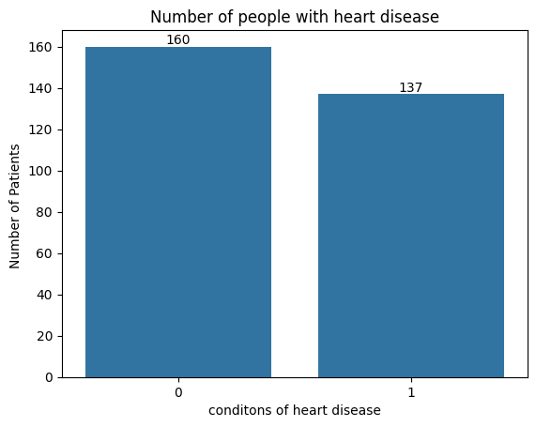
No. Patients vs Heart Disease Condition
Findings
From the data set there were total of 160 patients without the heart disease and 137 patients' with heart disease

Slide 9
